Slide 1

SYNOPSIS Presentation
on
Smart Productivity Planner by
Ashutosh Choubey 202410116100042
Anubhav 202410116100036
Anshu Patel 202410116100034
Session:2025-2026 (III Semester)
Under the supervision of
Mr. Roshan KR. Gupta
Department Of Computer Applications
KIET GROUP OF INSTITUTIONS, DELHI-NCR, GHAZIABAD-201206

Slide 2

AI-Powered Smart Productivity Planner
AI-Powered Smart Productivity
Empowering students and professionals to achieve more with intelligent task management and personalized insights.

Slide 3
Project Abstract: Beyond the Ordinary To-Do List
This React-based smart productivity assistant redefines task management for students and professionals. It integrates advanced features like AI suggestions, visual analytics, and gamification, offering a comprehensive solution that adapts to your unique needs.
For Students: Navigate semesters with ease—manage subjects, set priorities, track progress, and generate detailed reports.
For Professionals: Conquer deadlines with visual insights, productivity heatmaps, and seamless task handling.
Key differentiators include drag-and-drop task management, robust offline support with Supabase integration, and multi-format export capabilities (PDF, Excel, CSV).

Slide 4
Core Objectives: Enhancing Productivity & Planning
Seamless Task Management:- Provide an intuitive platform for efficient task creation, organization, and tracking. This includes CRUD operations (add, edit, delete, update tasks) with customizable priority levels (High, Medium, Low)
Dedicated Student Planner:- Offer a specialized module for students to manage semester subjects, exam schedules, assignment deadlines, and academic priorities with precision
AI & Motivation Boost:-Integrate AI-driven suggestions and personalized productivity tips. Enhance user engagement with motivational quotes, gamification elements, and smart notifications for upcoming deadlines.
4. Actionable Analytics & Reports:-Deliver visual tracking tools, comprehensive analytics, and progress reports to offer clear insights into productivity trends and task completion.
5. Universal Accessibility:- Ensure robust offline support and seamless cross-platform compatibility, including responsive design for desktop and mobile web experiences, allowing users to stay productive anywhere, anytime

Slide 5

Addressing Key Challenges
Content: Two-column layout.
  Column 1 (Problem - Traditional Apps):
    Lack student-focused features.
    No visual analytics.
    Struggle with motivation.
    Hard to export reports.
  Column 2 (Our Solution):
    Subject planning & exam tracking.
    Motivation through gamification.
    Visual performance analytics.
    Easy progress export.

Slide 6

Proposed System Capabilities
Content: (Uses icons and short descriptions)
  Task Organization: Drag-and-drop functionality.
  Student Module: Subject deadlines & progress.
  Productivity Insights: Charts & heatmaps.
  Motivation Tools: Pomodoro, quotes, gamification.
  Data Export: PDF, Excel, CSV.
  Offline Sync: Supabase synchronization.

Slide 7
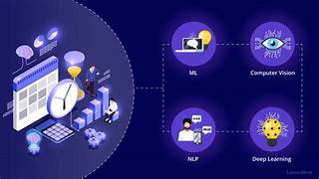
Slide Title: Comprehensive Features for Enhanced Productivity
1 Basic & Advanced Task Management
CRUD Operations: Easily Create, Read, Update, and Delete tasks.
Smart Scheduling: Set Due Dates, Reminders, and create Recurring Tasks for routines.
Organize & Prioritize: Categorize tasks (Pending, In-Progress, Done) and set Priority Levels (Low, Med, High).
Intuitive Interaction: Manage your workflow visually with Drag-and-Drop functionality.

Slide 8

2 AI & Productivity Power Tools
AI Task Assistant: Get intelligent suggestions for your most important tasks.
Voice Input: Add tasks hands-free using natural speech commands.
Deep Focus Mode: Integrated Pomodoro Timer and distraction-free environment.
Visual Urgency: Countdown Timers for critical deadlines.
Stay Motivated: Unlock Achievements & Badges and get daily Motivational Quotes.
3 Enhanced User Experience
Modern, Engaging UI with smooth animations.
Smart Dark/Light Mode that adapts to your system or personal preference.

Slide 9

Methodology

Slide 10






Modular Design for Scalability
Our project is structured into distinct modules, ensuring a robust, scalable, and easily maintainable architecture, allowing for future enhancements and seamless integration of new features.
User Module
Student Module
Manages user authentication, profiles, and personal task creation and organization.
Dedicated features for academic planning, including subject management, progress tracking, and exam countdowns.
Task Analytics Module
AI & Productivity Module
Provides visual insights, performance charts, and productivity heatmaps to track user progress.
Integrates AI task suggestions, Pomodoro timers, and a motivational quotes section to boost efficiency.
Export & Reporting Module
Backend & Database Module
Enables users to download tasks and progress reports in various formats (PDF, Excel, CSV).
Handles data storage with Supabase integration, ensuring real-time synchronization and offline capabilities.
Notes:
9

Slide 11
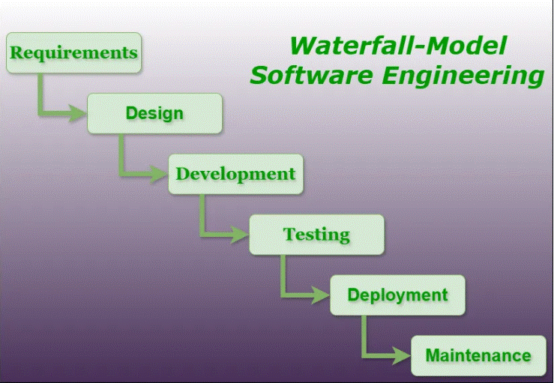
Methodology
1. Requirement Analysis – Identify needs of students and professionals.
2. System Design – Define architecture with React frontend and Super base backend.
3. Task Management – Implement drag-and-drop boards, reminders, and deadlines.
4. AI Integration – Suggest priorities, productivity tips, and learning insights.
5. Student Tools – Subject planner, exam countdown, and progress tracker.
6. Professional Tools – Productivity heatmaps, deadline monitoring, and reports.
7. Data Storage & Offline Support – Super base sync with local caching.
8. Export Options – PDF, Excel, and CSV reports for analysis.
9. Testing & Validation – Ensure usability, accuracy, and reliability.
10. Deployment – Host on cloud with continuous integration.

Slide 12
📖 Project Outcome
Web Application Development – Attendance system using AI + Spring Boot + MySQL.
Demonstrates real-world application of AI/ML in academics.
Future scope: Advance analytic Dashboard, Multi Campus Integration.
GANTT CHART
PHASE | Week 1 | 2 | 3 | 4 | 5 | 6 | 7 | 8 | 9 | 10 | 11 | 12 | 13 | 14 | 15 | 16 | 17 | 18
Requirement Analysis & Planning | ████ | ████
System Design |  |  | ████ | ████
Dataset Preparation |  |  |  |  | ████ | ████
Model Development |  |  |  |  |  |  | ████ | ████ | ████
Integration & Backend Development |  |  |  |  |  |  |  |  |  | ████ | ████ | ████
Frontend Development |  |  |  |  |  |  |  |  |  |  |  |  | ████ | ████
Testing & Debugging |  |  |  |  |  |  |  |  |  |  |  |  |  |  | ████ | ████
Deployment |  |  |  |  |  |  |  |  |  |  |  |  |  |  |  |  | ████
Documentation & Reporting |  |  |  |  |  |  |  |  |  |  |  |  |  |  |  |  |  | ████

Slide 13
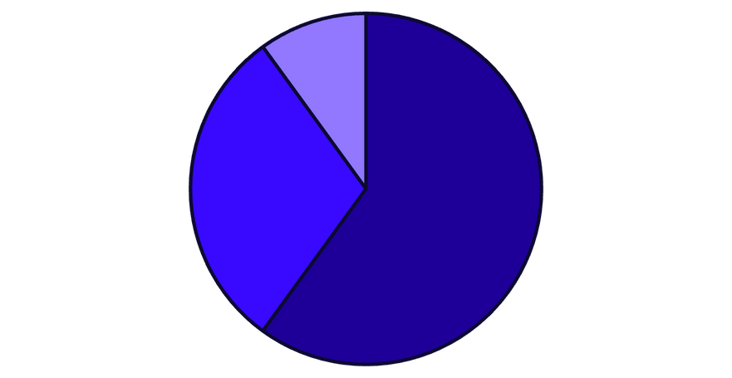
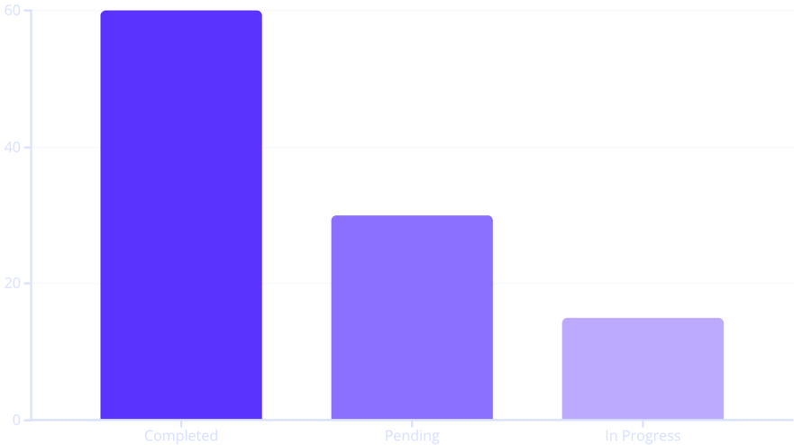
Visualizing Success: Analytics & Insights
Our powerful analytics module transforms your productivity data into clear, actionable insights, helping you understand your progress and optimize your workflow.
Completed
Pending
Overdue
Pie charts provide a quick overview of your task distribution, showing the proportion of completed, pending, and overdue tasks at a glance.
Bar graphs visually compare completed versus pending tasks and highlight your overall activity with GitHub-style productivity heatmaps, helping you identify peak productivity times.
Notes:
8

Slide 14




Conclusion & Future Vision
This project successfully delivers an innovative, student-focused productivity platform that extends far beyond conventional to-do applications. Designed to enhance task management and time efficiency, it caters equally to students, exam aspirants, and busy professionals.
Future Enhancements:
Native Mobile App
Develop a full-featured mobile application using React Native to ensure native performance and accessibility on iOS and Android devices.
Advanced AI Chatbot
Integrate a sophisticated AI chatbot assistant to provide personalized study plans, work schedules, and real-time productivity coaching.
Multi-Device Cloud Sync
Implement seamless cloud synchronization across all user devices, ensuring tasks and data are always up-to-date and accessible from anywhere.
Team Collaboration Features
Introduce robust features for team collaboration, enabling shared task lists, project assignments, and collaborative progress tracking for groups and teams.
Notes:
11

